Slide 1
Travelling Salesman Problem
Md Mehrab Hossain Opi

Slide 2
Introduction
Imagine you are a salesman.
You will sell your products in different cities.
You want to visit each city exactly once and return to your home.
Your goal is to minimize the total distance you will travel.

Slide 3
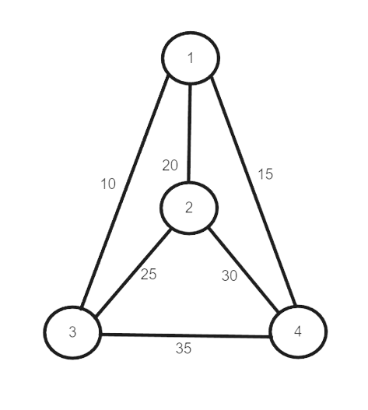
Introduction
Consider the graph.
What will be the minimum cost to achieve your goal?

Slide 4
Introduction
Consider the path
  1 → 3 → 2 → 4 → 1
The total cost
  10 + 25 + 30 + 15 = 80
So how do we solve this problem?

Slide 5
TSP solutions
It is an NP-hard problem in combinatorial optimization.
  No known polynomial time solution.
Traditional line of attacks for NP-hard problems
  Exact algorithm
    Works reasonably first for small problem sizes.
  Suboptimal/ Heuristic algorithm
    Delivers approximated solutions in a reasonable time.
  Special Cases Detection
    Either better or exact solution are possible.

Slide 6
Exact Solution (Permutation)
Consider city 1 as starting and ending point.
  Any node will work as the route is cyclic.
Generate all (n-1)! permutations of cities.
Calculate the cost of each permutation and keep track of the minimum cost permutation.
Return the permutation with the minimum cost.
Time Complexity
  O(n!)

Slide 7
Exact Solution (Permutation)
Initialize an array with values from 2 to n.
  A = {2,3,4}
Take all the permutations
  {2,3,4}
  {2,4,3}
  {3,2,4}
  {3,4,2}
  {4,2,3}
  {4,3,2}
Calculate the cost of permutations
  {2,3,4}
  1 → 2 → 3 → 4 → 1
  (20+25+35+15) = 95

Slide 8
Exact Algorithm (Backtracking)
Start with city 1.
Start traversing to adjacent nodes in dfs manner.
Calculate cost of every traversal.
  Keep track of minimum cost and keep on updating the value of minimum cost stored value.
Return the permutation of minimum cost.

Slide 9
Exact Algorithm (Backtracking)
Start with 1.
First discovered path in dfs
  1 → 2 → 3 → 4 → 1
  Total cost 95.
  Backtrack
Second discovered path
  1 → 2 → 4 → 3 → 1
  Total cost 95.
  Backtrack.
Third discovered path
  1 → 3 → 2 → 4 → 1
  Total cost 80.
Repeat till all paths are discovered.

Slide 10
Exact Algorithm (Backtracking)
Time Complexity
  O(n!)
For the first node there are n possibilities.
  For second node there are n-1 possibilities.
For n nodes: n * (n-1) * … 1 = O(n!)

Slide 11
Exact Solution (Dynamic Programming)
Lets consider 1 as starting point.
For every other vertex i other than 1, we find the minimum cost path with 1 as the starting point, i the ending point and all vertices appearing exactly once.
Let it be cost(i).
We need the minimum of cost(i)+dist(i,1).

Slide 12
Exact Solution (Dynamic Programming)
Define C(S,i) – cost of the minimum cost path visiting each vertex in S exactly once, starting at 1 and ending at i.
Start with subsets of size 2 and gradually increase the size.
1 must be present in every subset.
If size of S is 2 then S must be {1,i}.
  C(S,i) = dist(1,i)
Else
  C(S,i) =min{ C(S-{i},j)+dis(j,i)}
    J belongs to S, j!=i and j!=1.

Slide 13
Exact Solution (Dynamic Programming)
To maintain the subsets we can use bitmasks.
  Faster to operate and only a few nodes are in the graph.
01101 = 18
  Nodes 1 and 4 are left to be processed.

Slide 14
Exact Solution (Dynamic Programming)
Implementation
  TSP DP solution - Pastes.io
Complexity
  O(n² x 2^{n}) Time Complexity
  O(n x 2^{n}) Memory Complexity

Slide 15
Approximation Algorithm
What is approximation algorithm?
  Algorithm that provides a reasonably good solution for optimization problems.
  Does not guarantee the best solution.
  Runs in polynomial time.

Slide 16
Approximation Algorithm (Nearest Neighbor)
Choose a starting city arbitrarily.
Visit the nearest unvisited city.
Repeat step 2 until all cities are visited.
Return to the starting city.
Greedy approach.

Slide 17
Approximation Algorithm (MST Approach)
Create a minimum spanning tree from the given graph.
  Use Prim’s / Kruskal’s Algorithm
Traverse the MST to create a tour.
  Use any traversal method.
  Visit each city exactly once except for the starting one.

Slide 18
Approximation Algorithm (Christofides Algorithm)
Find a minimum spanning tree for the problem
Create a matching for the problem with the set of cities of odd order.
Find an Eulerian tour for this graph
Convert to TSP using shortcuts.
At most 1.5x optimal.

